Slide 1

Chapter 12: Growth Theory
Wayne Geerling
University of Texas

Slide 2
Big Questions
How do macroeconomic theories evolve?
What is the Solow growth model?
How does technology affect growth?
Why are institutions the key to economic growth?

Slide 3

Evolution of Economic Theories
Good economic models are simple, flexible, and useful for making accurate predictions.
Real-World Observations
Policy
Economic Theory

Slide 4
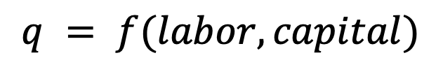
Production Function
Production function: relationship between the inputs a firm uses & the output it creates.
For a country, inputs are labor, capital & natural resources & output is GDP
$$q = f(labor, capital)$$
$$GDP= Y=F(labor, capital, natural resources)$$

Slide 5

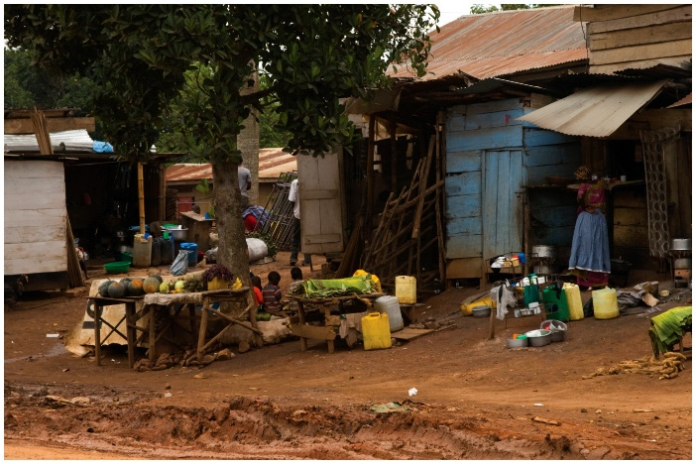
Focus on Physical Capital
The first version of the Solow model focused on capital (rather than resources or labor).
Reasoning:
Increasing tools available can increase output per worker
Capital in wealthy nations exceeds capital in developing nations
Periods of investment growth are periods of expansion

Slide 6
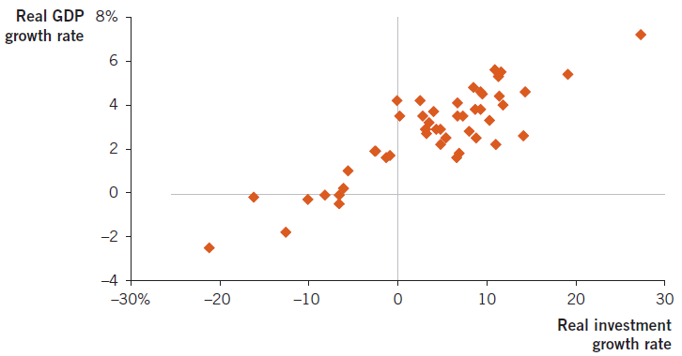
U.S. Investment & GDP Growth
Investment is highly correlated with GDP growth but that does not imply causation.

Slide 7

Marginal Product
To measure the impact of resources, economists think about marginal product.
Marginal product: change in output associated with one additional unit of an input.
A resource’s marginal product declines as the quantity of the resource increases.

Slide 8

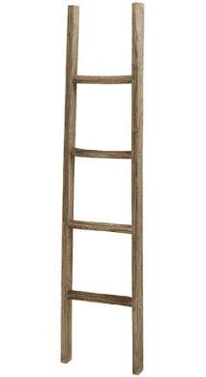
Solow Growth Model: Castaway
Output = Y = Coconuts
Capital = K = Ladders

Slide 9
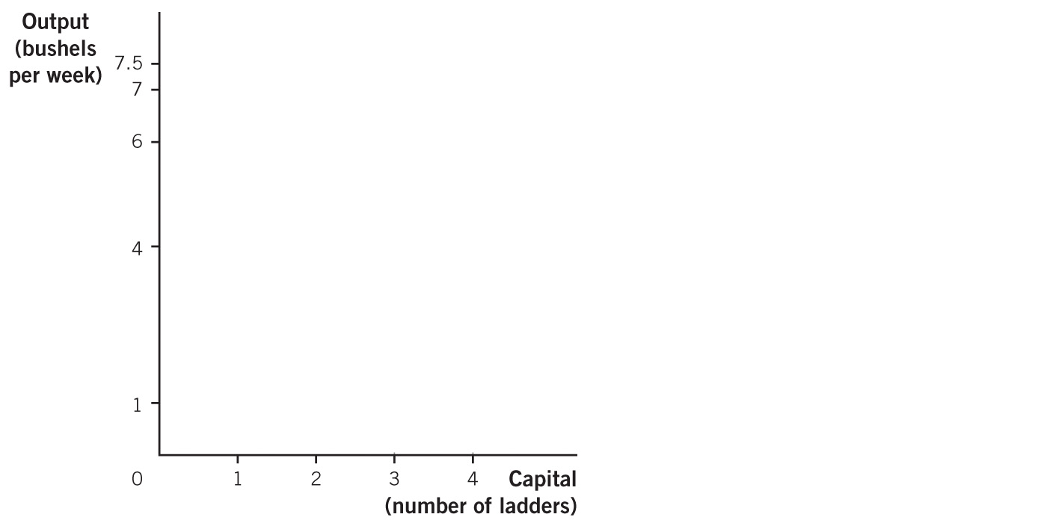
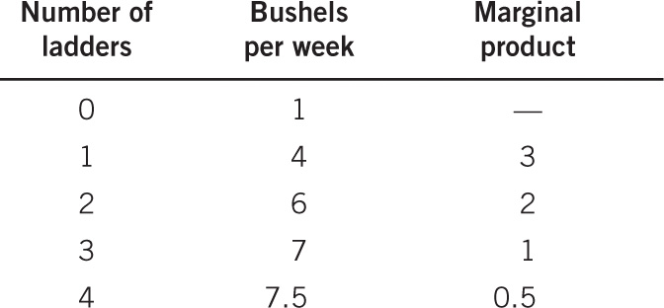


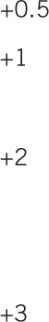
Production Function Example
Diminishing marginal product occurs when the marginal product of an input as the quantity of the input

Slide 10
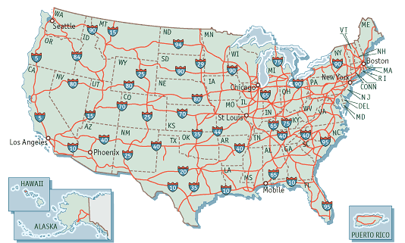
Diminishing Returns on Our Interstates

Slide 11
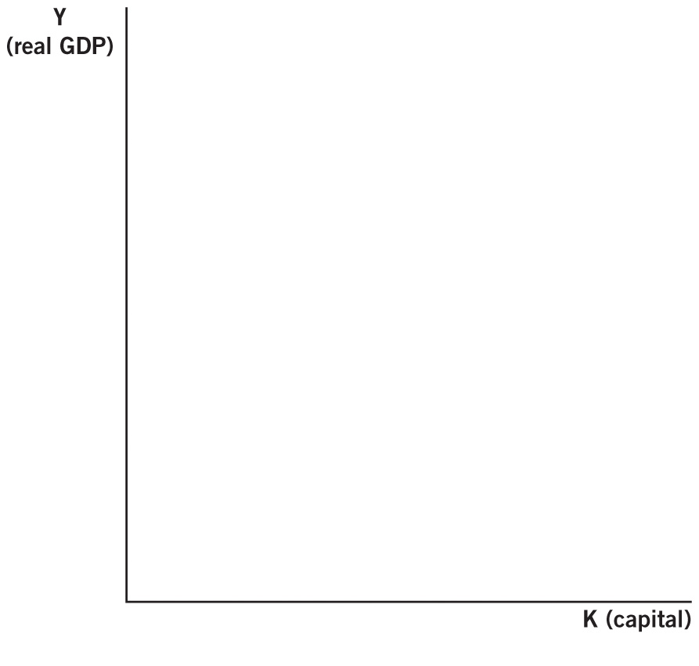
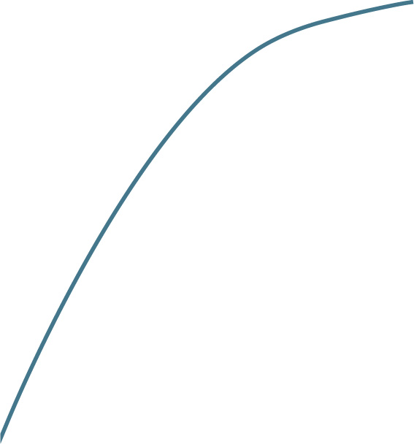
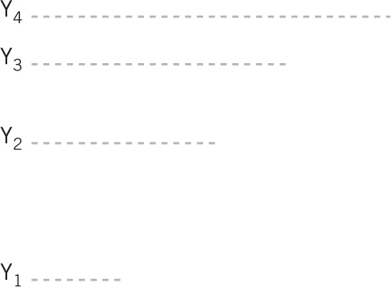
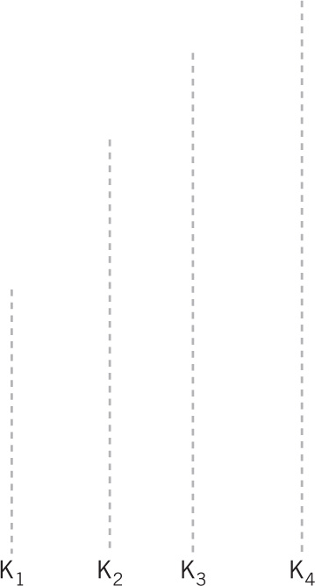
Aggregate Production Function

Slide 12
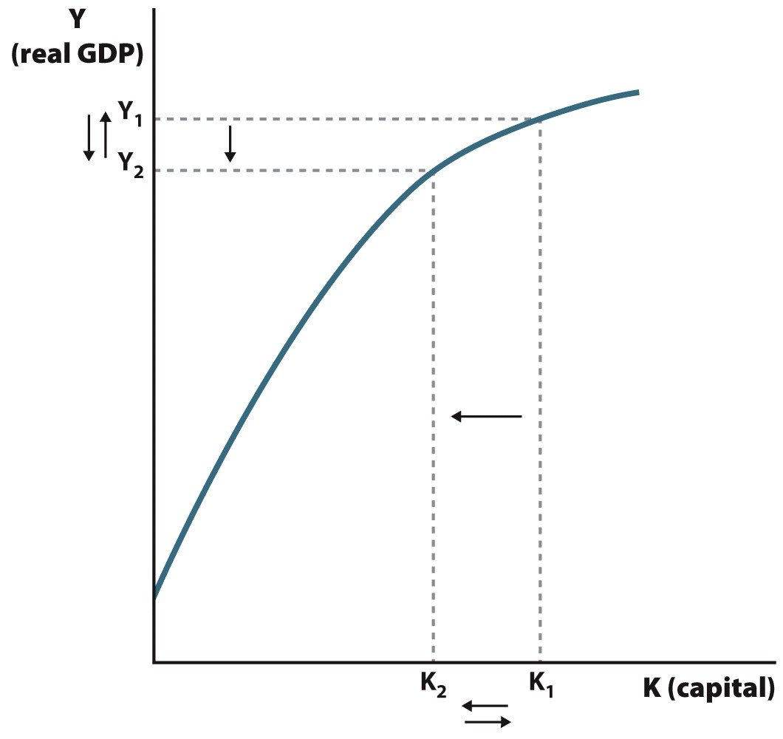
Changes in Resources: Natural Disasters

Slide 13

Implications of Solow I
There are 2 key implications from the Solow I model:
1. Steady state
2. Convergence

Slide 14
Steady State
The condition of a macroeconomy when there is no new
There is no change in or at this point.
As MPK decreases, there will be a point where the cost of investment > gains of investment so there will no longer be an incentive to the capital stock.

Slide 15

Convergence
Idea that per capita GDP across nations as nations approach
Application of marginal product
Poor nations should “catch up” quickly
Lower levels of
should be higher
Return on investment should be

Slide 16
Convergence

Slide 17
Evidence of Solow I
Empirical with Solow I model.
Growth in wealthy nations outpaces growth in poor countries.
While some poor countries have grown, most poor countries have
No sign of : gap between rich & poor countries is
Because evidence does not Solow I, economists have the model.

Slide 18
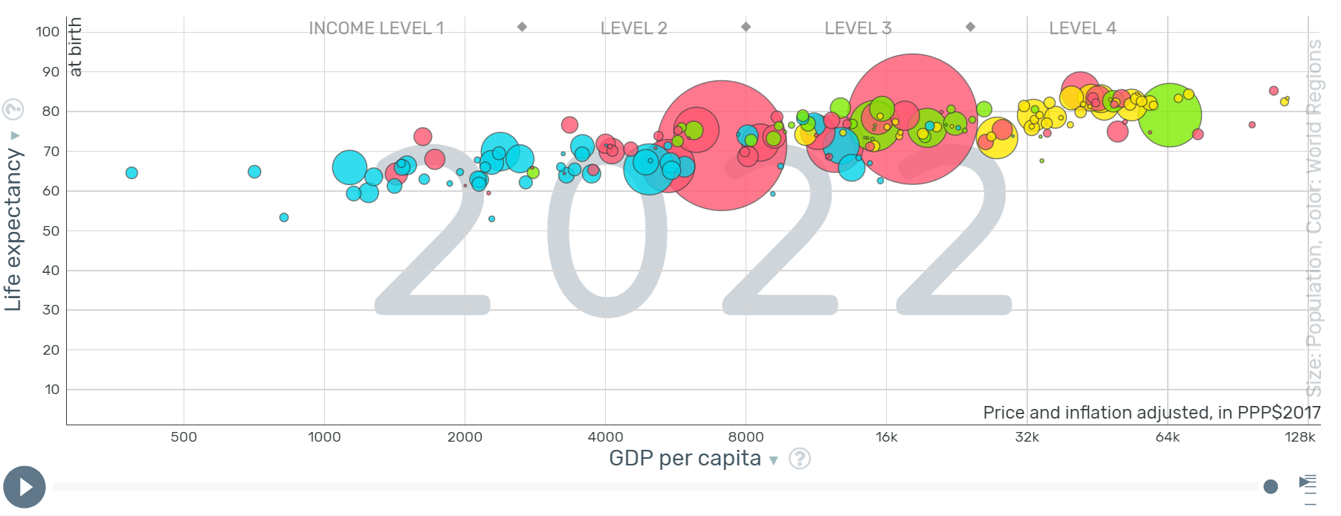
GDP/Life Expectancy and Growth

Slide 19
Capital and Growth
Capital appears to cause economic growth.
Strong between wealth & output.
Workers are more productive with more tools.
However, capital alone is enough to explain sustained growth.
Need a more advanced version of the Solow model to explain economic growth.

Slide 20

Solow II: Technology Matters
Solow II acknowledges how can lead to economic growth.
With technology, nations can produce output with each input unit.
Graphically, MPK, shifting the production function

Slide 21
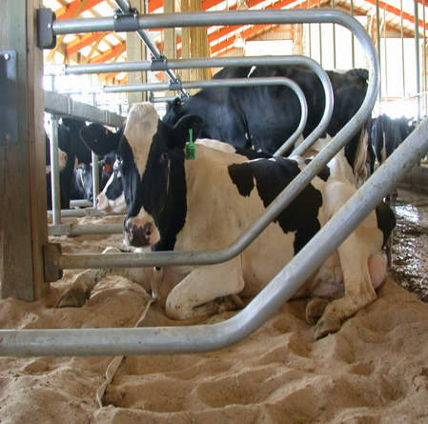
Milk: How It’s Made

Slide 22
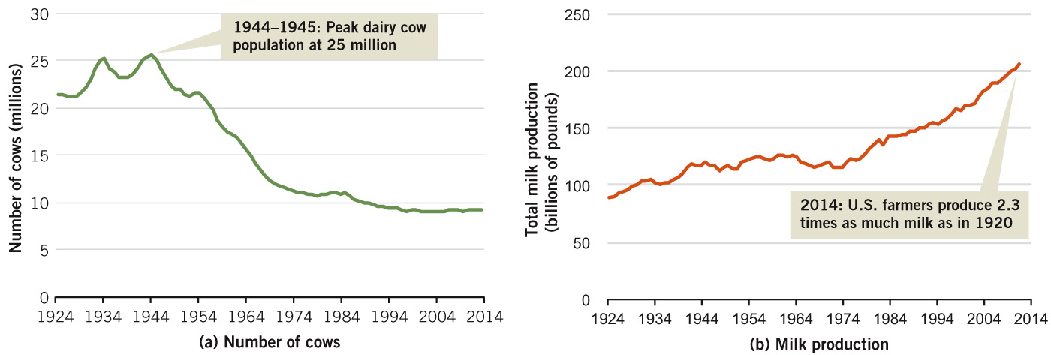
Milk Production
Through a series of technological advancements, U.S. farmers can produce more milk than ever with many fewer cows.

Slide 23
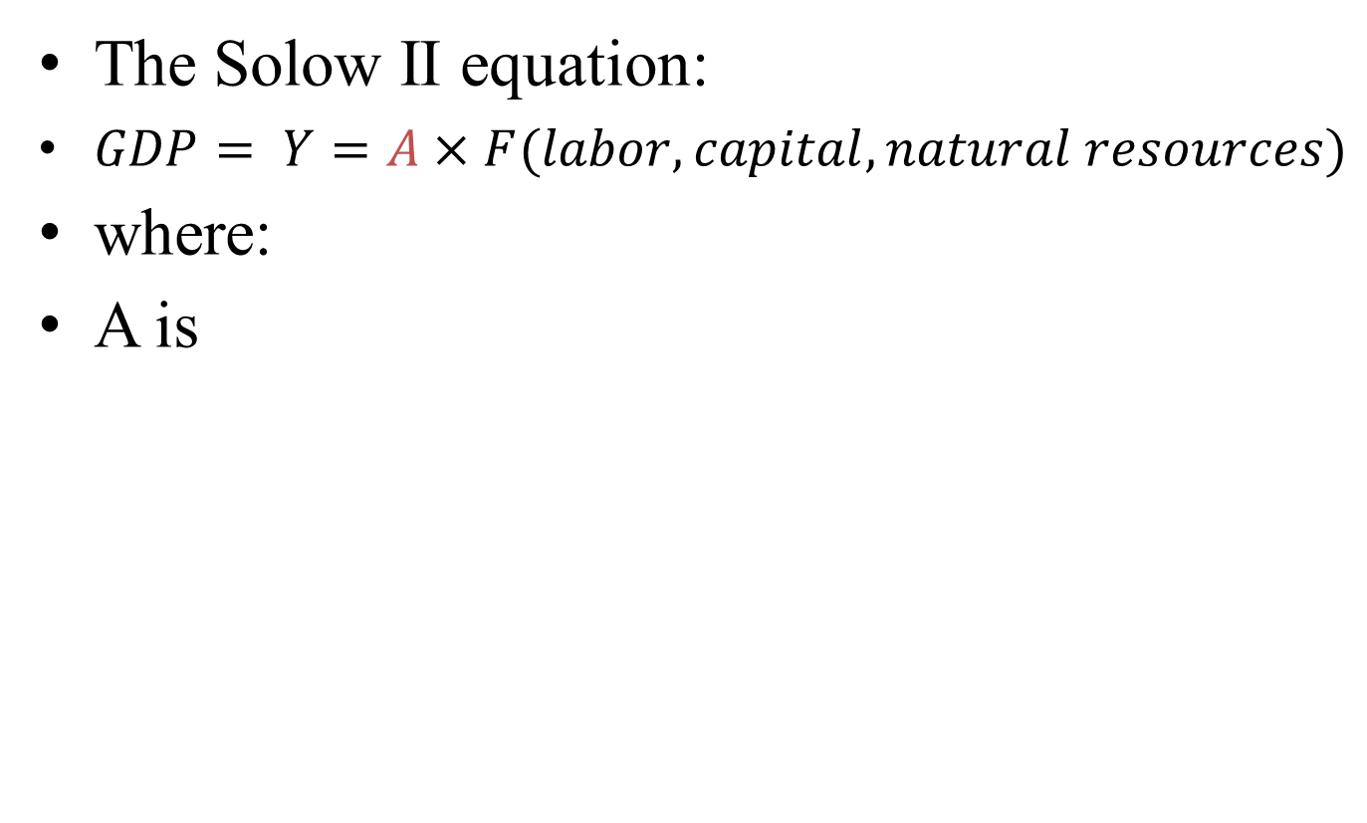
Solow II: Technology Matters
The Solow II equation:
$GDP= Y=A×F(labor, capital, natural resources)$
where:
A is

Slide 24
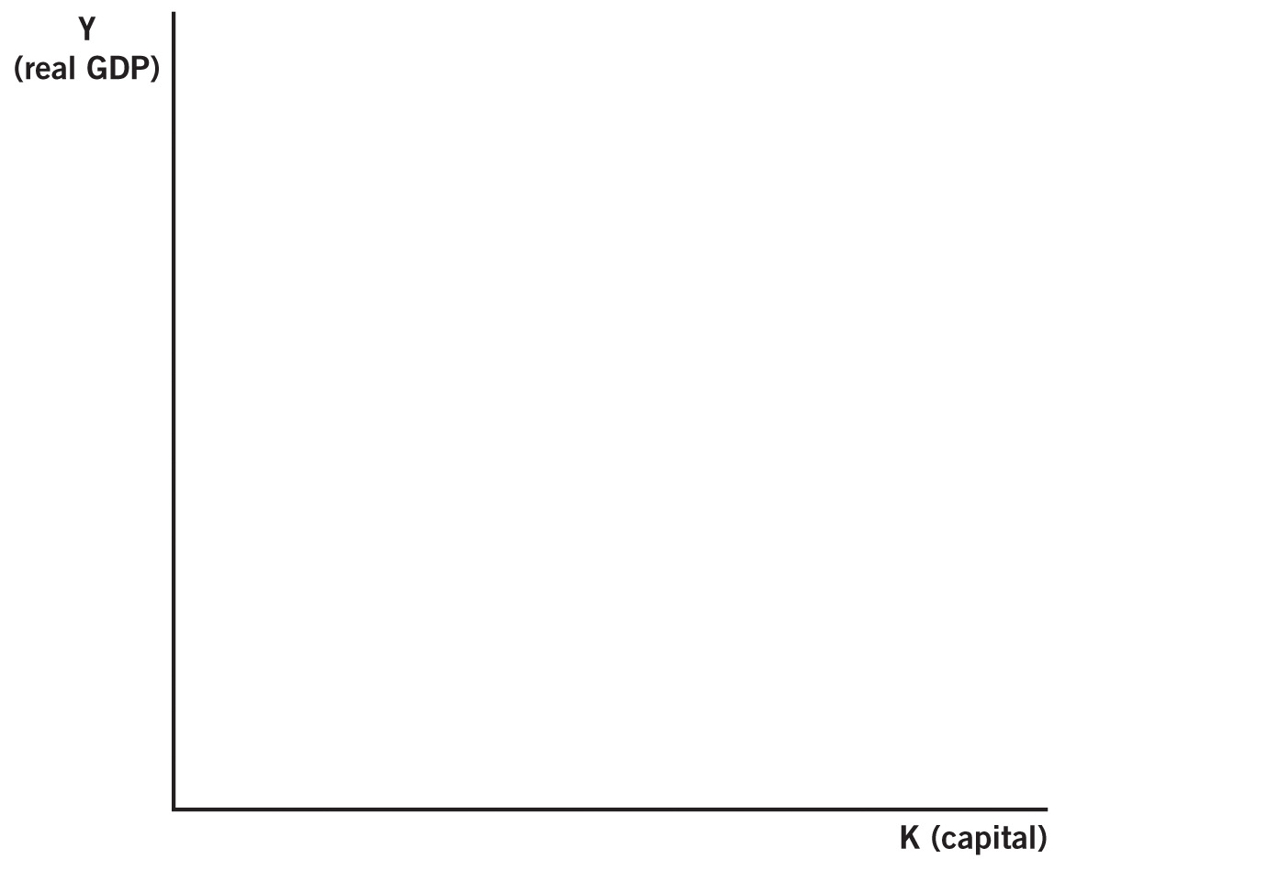
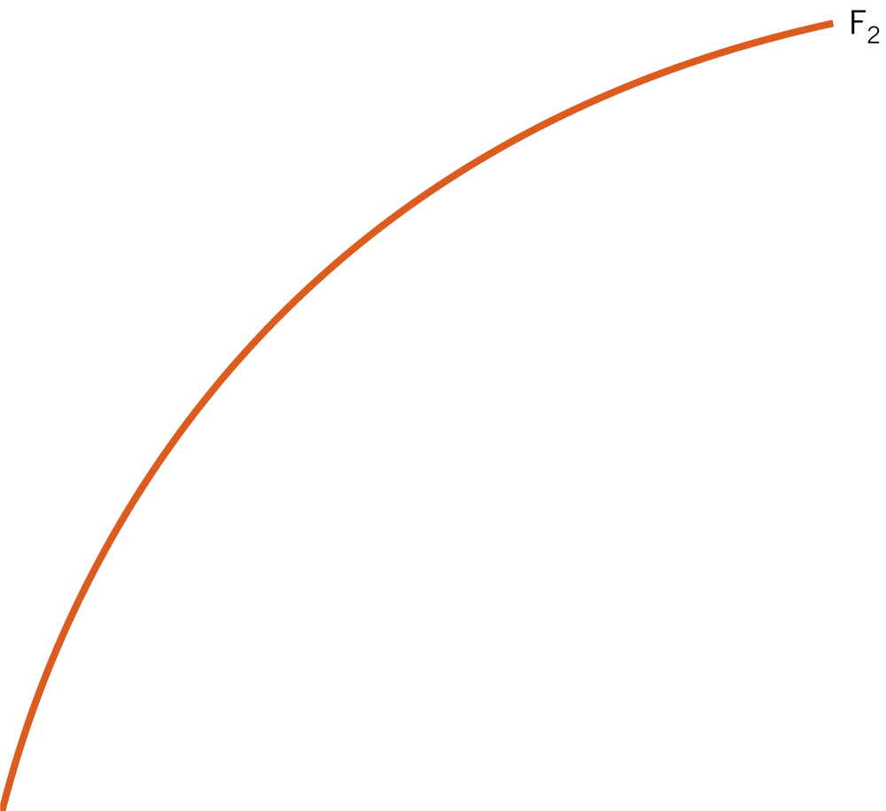
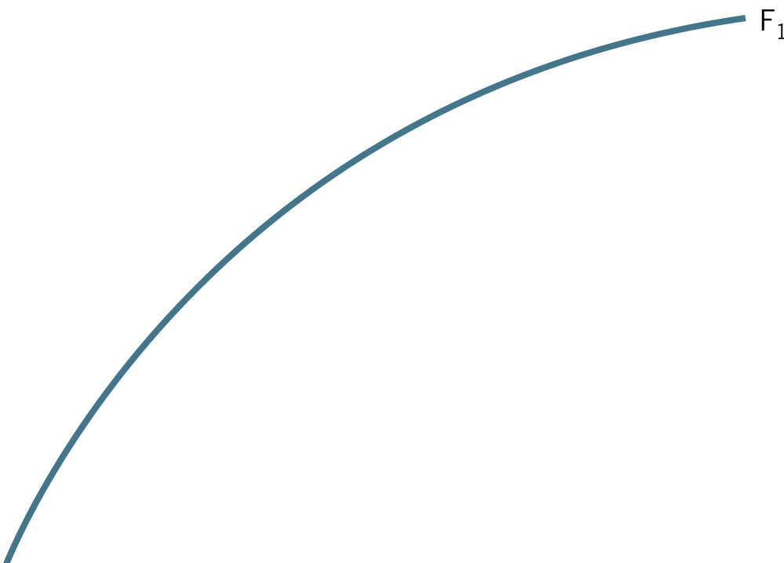
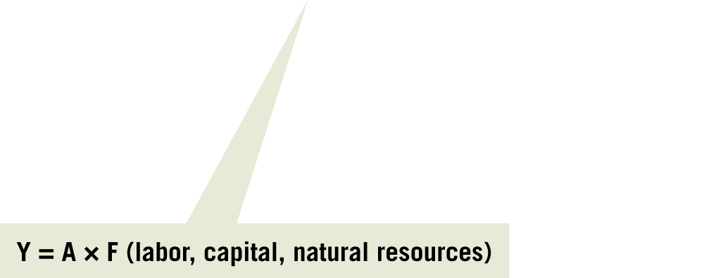
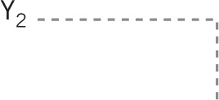
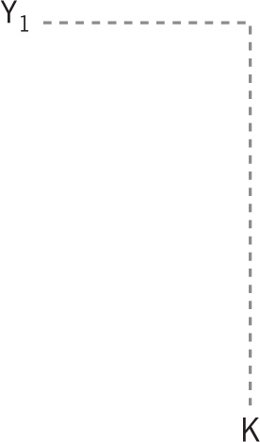
Solow II: New Technology

Slide 25
Exogenous Technological Change
Solow II assumes that changes in technology are
Exogenous technology is related to what is happening inside the economy.
Two reasons for this assumption:
1. Technological progress often is lucky and
2. It made the theoretical models easier to

Slide 26
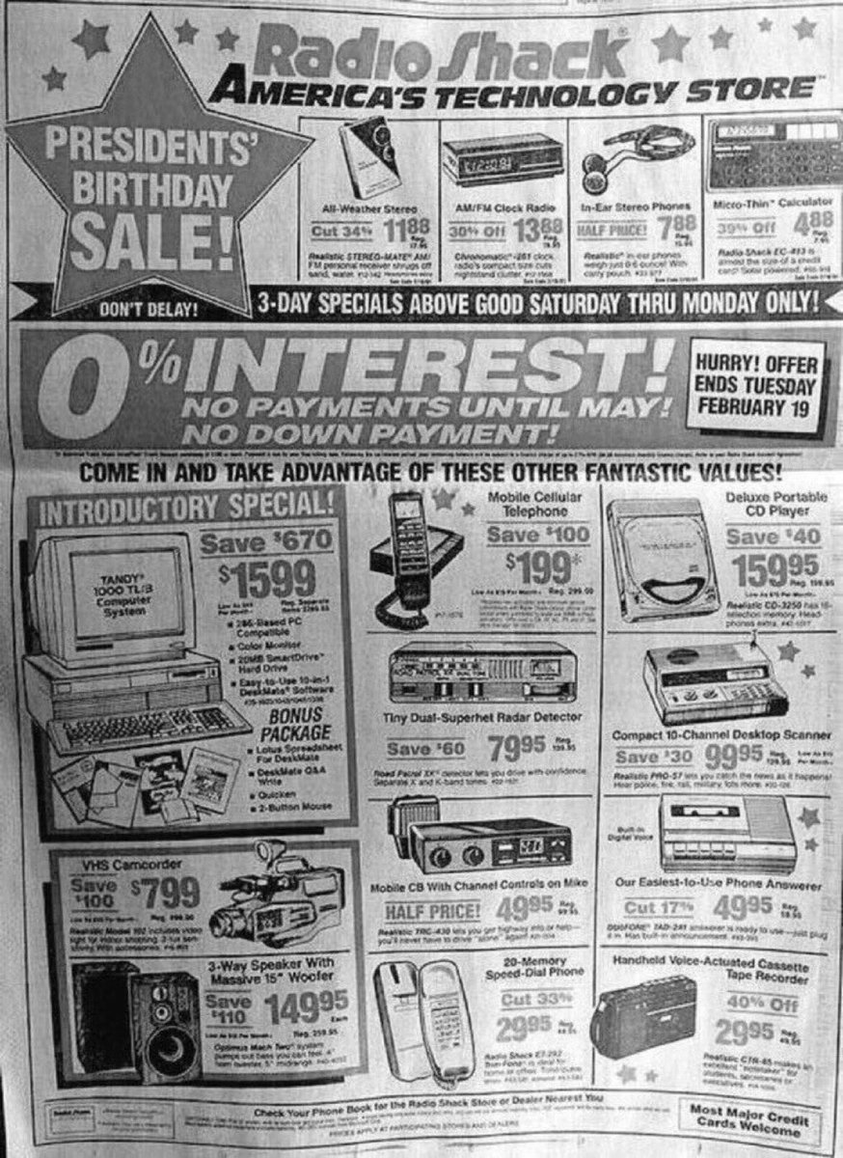
Almost everything from this 1991 Radio Shack ad is now available on a $200 smartphone.

Slide 27
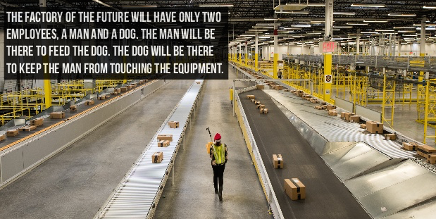

Slide 28
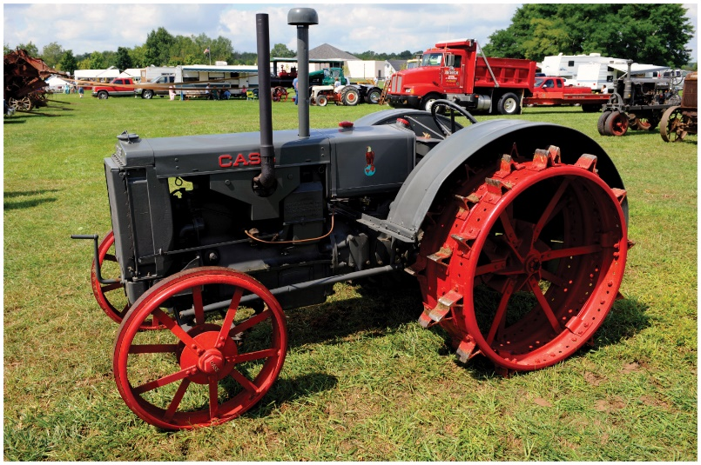
Policy Implications of Solow II
Solow II emphasizes the importance of and
For low-income countries to grow, they need the technology available.
High-income countries can help by capital investment in poor countries.

Slide 29
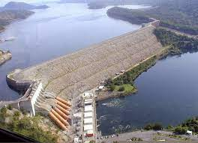
Solow II Implementation
Two types of aid in the 1950s & 1960s:
Actual goods were built with aid.
Aid was given to developing countries to fund
Akosombo Dam built in Ghana in 1964

Slide 30
Solow II Implementation
Results of these policies:
Some countries received billions in aid & are no better off today than they were in 1960.
Zimbabwe, Liberia & Haiti.
Some countries received almost no aid and have grown rapidly.
Taiwan, Chile, China & India

Slide 31
Solow Case Study: Africa
From 1956 to 1977:
37 African countries achieved independence.
Unique opportunity to apply the Solow model.
Heavy capital investment projects in Africa.
Results:
50 years later, policies across the continent.
Incomplete growth theory, faulty policy.
Observations led to a reexamination of growth theory.

Slide 32
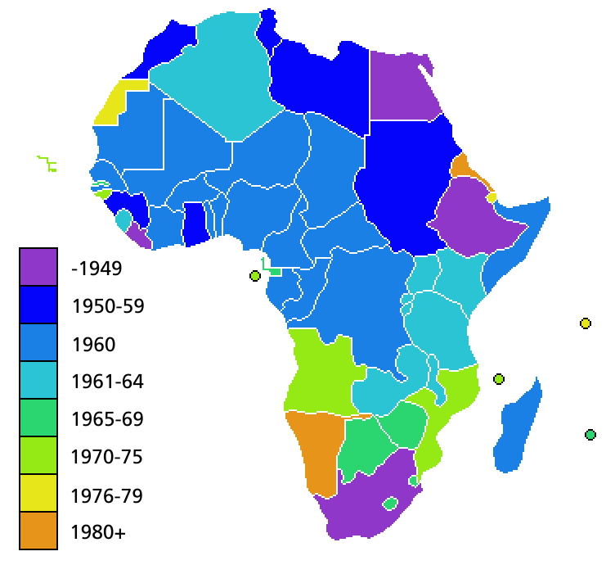
Solow Wrap-up
African Independence Dates:
37 nations from 1956-1977

Slide 33
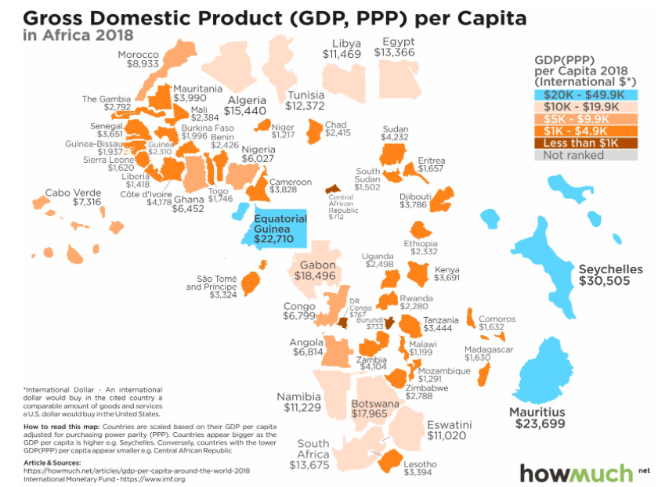
Africa
Source: https://howmuch.net/articles/gdp-per-capita-around-the-world-2018

Slide 34

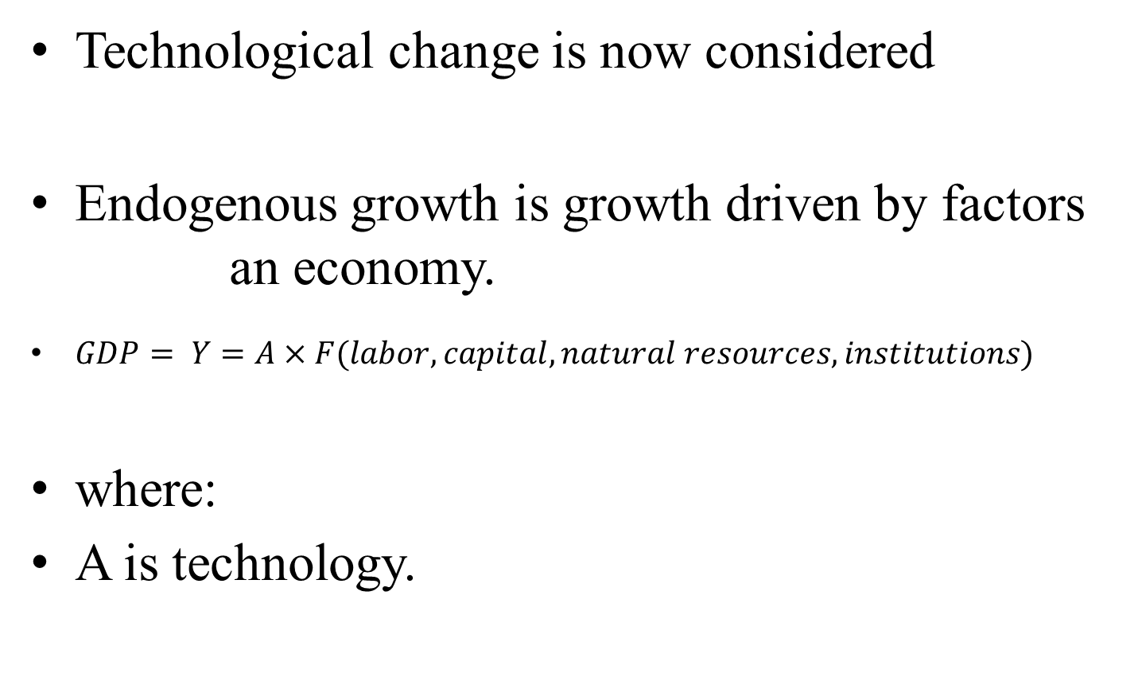
New Growth Theory
Technological change is now considered
Endogenous growth is growth driven by factors an economy.
$GDP= Y=A×F(labor, capital, natural resources, institutions)$
where:
A is technology.

Slide 35
Institutions
Because technological change is , nations need to create an environment that encourages technological change.
The right institutions to economic growth.
institutions: transparent & consistent government, private property rights, stable money & prices.
institutions: corruption, political instability.

Slide 36
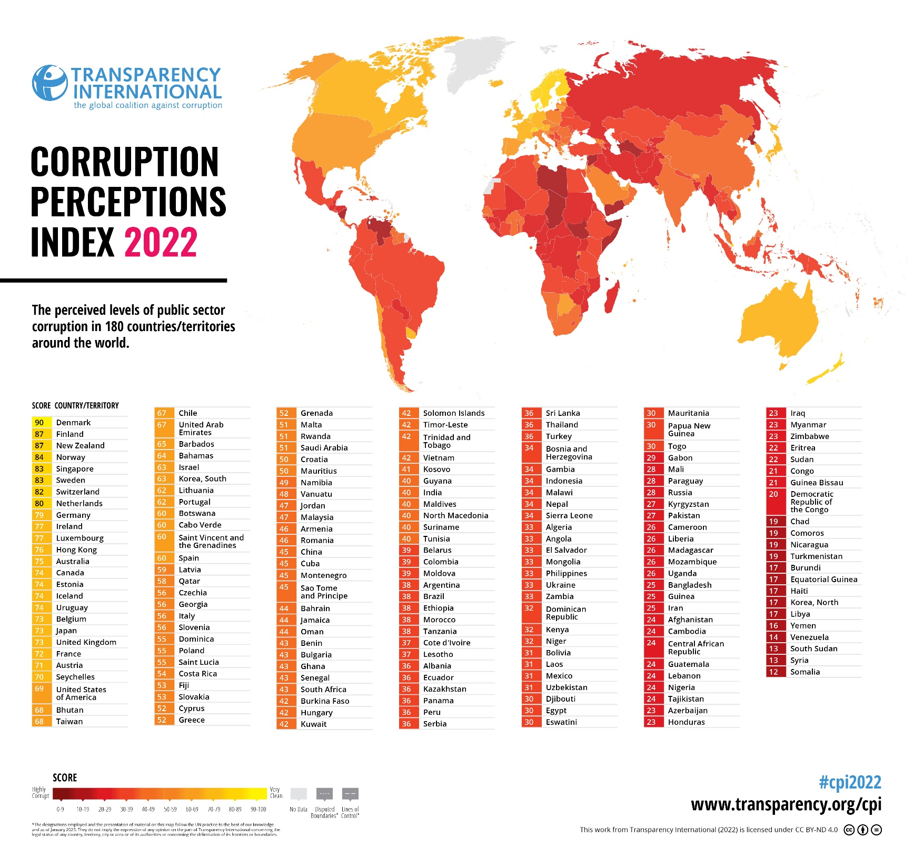

Slide 37
Institutions That Foster Growth
1. Political stability and rule of law
2. Private property rights
3. Competitive markets
4. International Trade
5. The flow of funds across borders
6. Efficient taxes
7. Stable money and prices

Slide 38
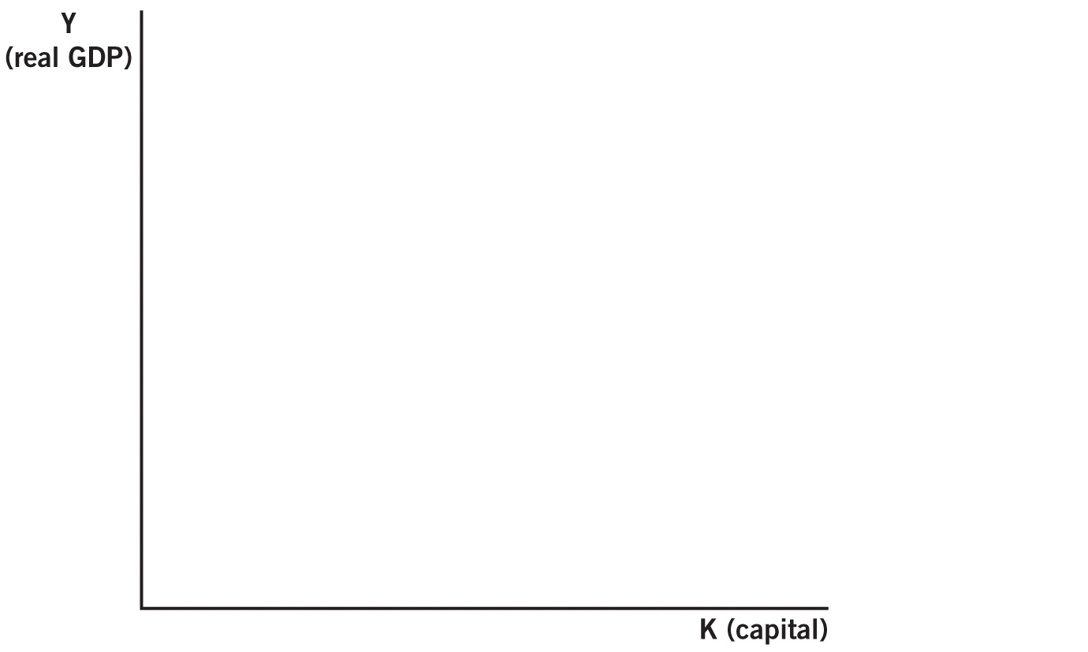
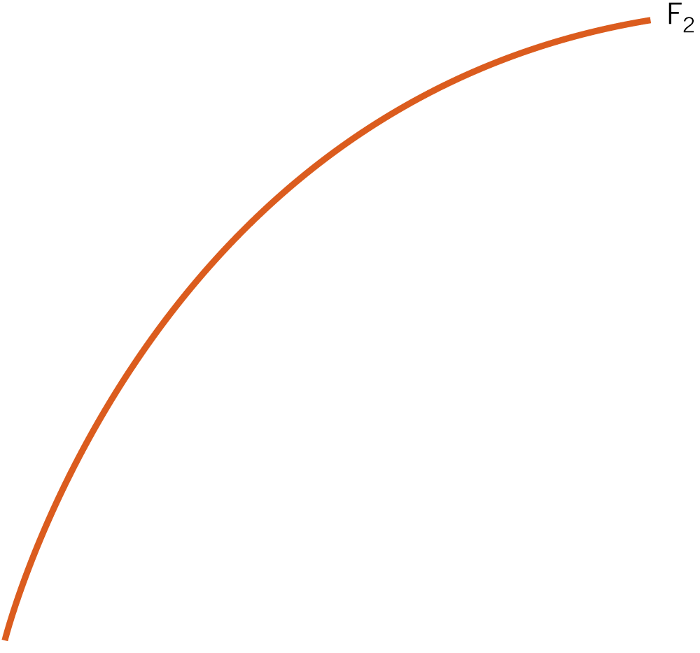

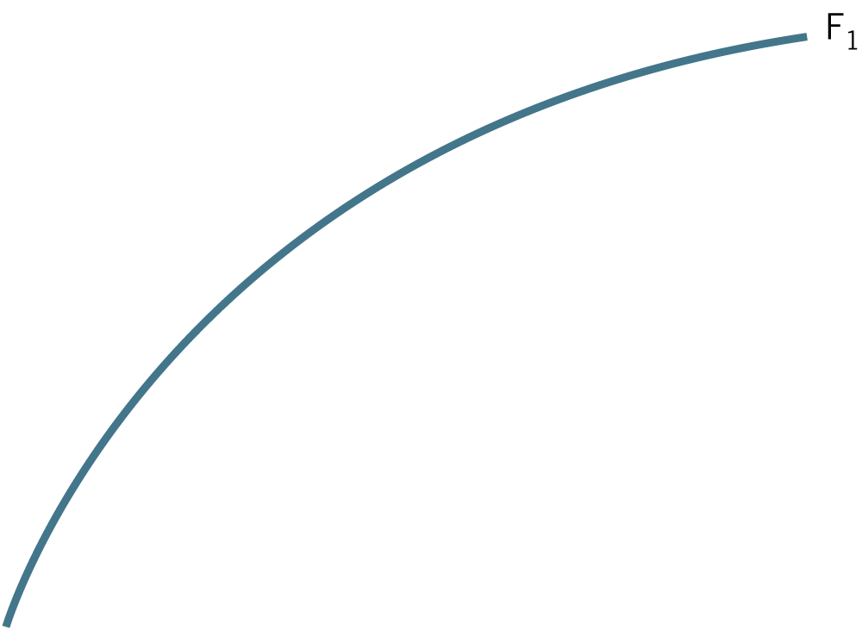
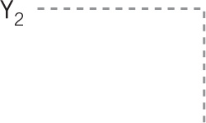
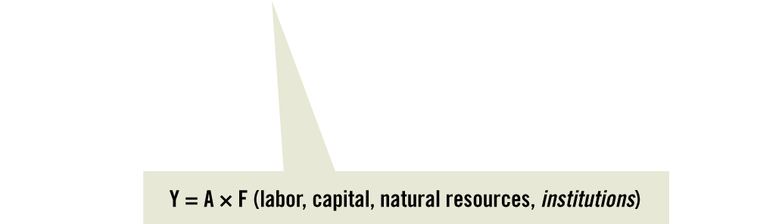

Changes in Institutions

Slide 39
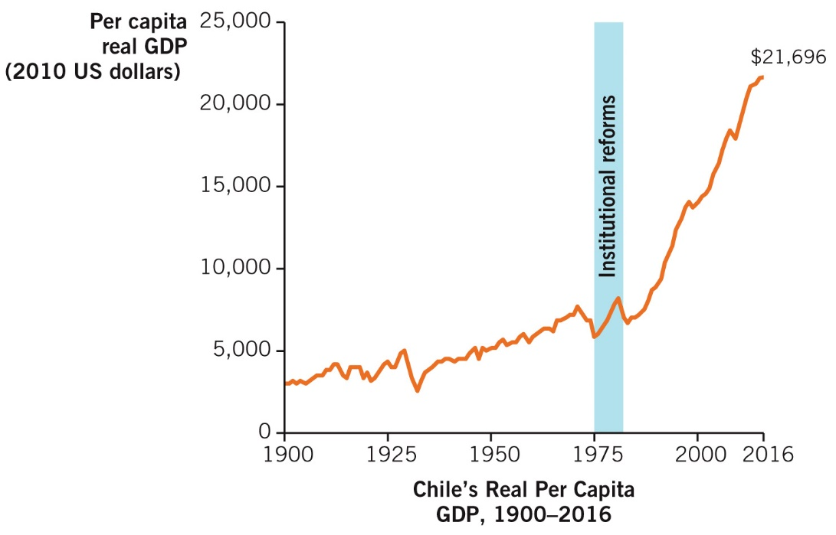
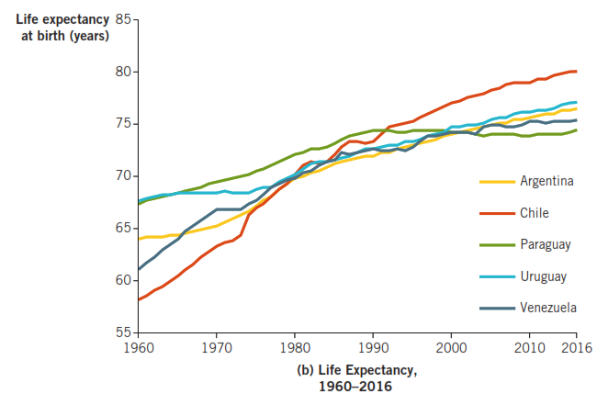
Modern Growth Theory Case: Chile
From 1900-85, Chile grew by < %. In 1975, Chile began drastic economic reforms. From 1985 to 2016, growth averaged %.

Slide 40

Trend in the Lifetime Distribution of Discretionary Time
Activity | 1880 | 1995 | 2040
Lifetime Discretionary Hours | 225,900 | 298,500 | 321,900
Lifetime Work Hours | 182,100 | 122,400 | 75,900
Lifetime Leisure Hours | 43,800 | 176,100 | 246,000
Notes: Discretionary hours exclude hours used for sleep, meals and hygiene. Work hours include paid work, travel to and from work, and household chores.
http://www.eh.net/encyclopedia/article/whaples.work.hours.us

